Slide 1
Using JWT (JSON Web Tokens) in JAX-RS

Slide 2
CONTENT
Company LOGO
I. Introduction
II. Structure
III. Tools and Libraries
IV. Using JWT in JAX-RS

Slide 3
I. Introduction
Company LOGO
JSON Web Token (JWT) is an open standard (RFC 7519) that defines a compact and self-contained way for securely transmitting information between parties as a JSON object.
Compact: Because of their smaller size, JWTs can be sent through a URL, POST parameter, or inside an HTTP header. Additionally, the smaller size means transmission is fast.
Self-contained: The payload contains all the required information about the user, avoiding the need to query the database more than once.
Notes:
JWTs can be signed using a secret (with the HMAC algorithm) or a public/private key pair using RSA.

Slide 4
I. Introduction
Company LOGO
When should you use JSON Web?
Authentication: This is the most common scenario for using JWT. Once the user is logged in, each subsequent request will include the JWT, allowing the user to access routes, services, and resources that are permitted with that token.
Information Exchange: JSON Web Tokens are a good way of securely transmitting information between parties. Because JWTs can be signed—for example, using public/private key pairs—you can be sure the senders are who they say they are. Additionally, as the signature is calculated using the header and the payload, you can also verify that the content hasn't been tampered with.

Slide 5
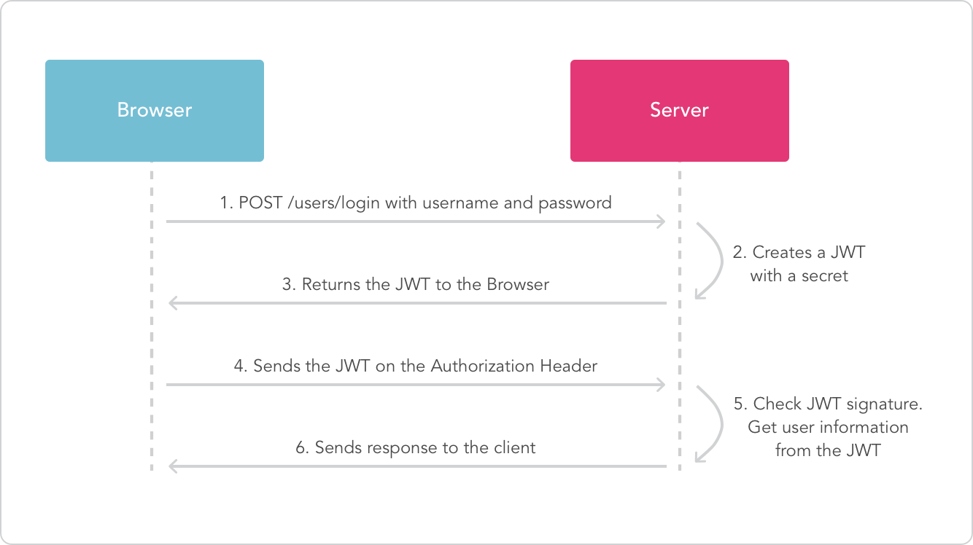
Source: https://jwt.io/introduction/
Notes:
Whenever the user wants to access a protected route or resource, the user agent should send the JWT

Slide 6
II. Structure
All JWTs are constructed from three diﬀerent elements separated by dots ( . ), which are:
Header
Payload
Signature
Claims are definitions or assertions made about a certain party or object. Some of these claims and their meaning are defined as part of the JWT spec. Others are user defined.
Notes:
These three elements are separated by dots (“.”) in order: the header, the payload, and the signature.
The first two elements are JSON objects of a certain structure. The third is dependent on the algorithm used for signing or encryption.

Slide 7
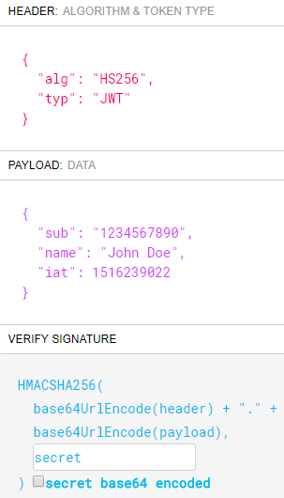
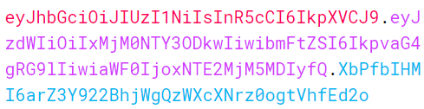
Source: https://jwt.io/#debugger

Slide 8
1. Header
Every JWT carries a header with claims about itself.
The only mandatory claim is the alg claim: the main algorithm in use for signing and/or decrypting this JWT.
Optional header claims include the typ and cty claims:
typ: the media type of the JWT itself. When present, this claim should be set to the value JWT
cty: the content type
It is possible to add additional, user-defined claims to the header. This is generally of limited use, unless certain user-specific metadata is required in the case of encrypted JWTs before decryption

Slide 9
2. Payload
The payload is the element where all the interesting user data is usually added. Just like the header, the payload is a JSON object. No claims are mandatory.
Three types of claims:
Registered Claims: These are a set of predefined claims which are registered in the IANA JSON Web Token Claims registry
Public claims: These can be defined at will by those using JWTs. But to avoid collisions they should be defined in the IANA JSON Web Token Registry or be defined as a URI that contains a collision resistant namespace.
Private claims: These are the custom claims created by users to share information between parties that agree on using them and are neither registered or public claims.

Slide 10
2. Payload
Registered Claims: iss, sub, aud, exp, nbf, iat, jti
In practice, most claims are either registered claims or private claims. Just as in the JSON parsing rules, duplicate claims (duplicate JSON keys) are handled by keeping only the last occurrence as the valid one.
Notes:
- iss: from the word issuer. A case-sensitive string or URI that uniquely identifies the party that issued the JWT. Its interpretation is application specific (there is no central authority managing issuers).
- sub: from the word subject. A case-sensitive string or URI that uniquely identifies the party that this JWT carries information about. In other words, the claims contained in this JWT are statements about this party. The JWT spec specifies that this claim must be unique in the context of the issuer or, in cases where that is not possible, globally unique. Handling of this claim is application specific.
- aud: from the word audience. Either a single case-sensitive string or URI or an array of such values that uniquely identify the intended recipients of this JWT. In other words, when this claim is present, the party reading the data in this JWT must find itself in the aud claim or disregard the data contained in the JWT. As in the case of the iss and sub claims, this claim is application specific.
- exp: from the word expiration (time). A number representing a specific date and time in the format “seconds since epoch” as defined by POSIX6. This claims sets the exact moment from which this JWT is considered invalid. Some implementations may allow for a certain skew between clocks (by considering this JWT to be valid for a few minutes after the expiration date)
- nbf: from not before (time). The opposite of the exp claim. A number representing a specific date and time in the format “seconds since epoch” as defined by POSIX7. This claim sets the exact moment from which this JWT is considered valid. The current time and date must be equal to or later than this date and time. Some implementations may allow for a certain skew.
- iat: from issued at (time). A number representing a specific date and time (in the same format as exp and nbf) at which this JWT was issued.
- jti: from JWT ID. A string representing a unique identifier for this JWT. This claim may be used to diﬀerentiate JWTs with other similar content (preventing replays, for instance). It is up to the implementation to guarantee uniqueness.
Do not put secret information in the payload or header elements of a JWT unless it is encrypted.

Slide 11
3. Signature
To create the signature part you have to take the encoded header, the encoded payload, a secret, the algorithm specified in the header, and sign that.
For example if you want to use the HMAC SHA256 algorithm, the signature will be created in the following way:
HMACSHA256( base64UrlEncode(header) + "." + base64UrlEncode(payload),
secret)

Slide 12
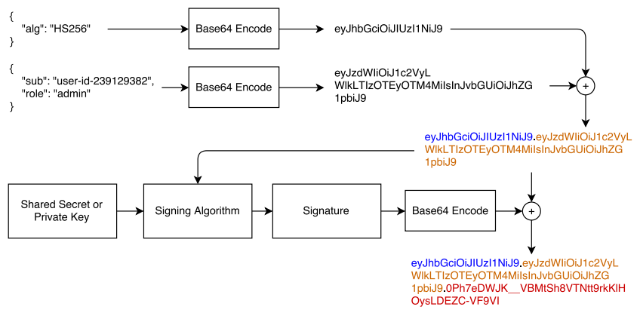
II. Structure
Source: JWT Handbook – by Sebastián Peyrott (page 33)
Notes:
These three elements are separated by dots (“.”) in order: the header, the payload, and the signature.
The first two elements are JSON objects of a certain structure. The third is dependent on the algorithm used for signing or encryption.

Slide 13
III. Tools and Libraries
There are a lot of libraries supporting JWT on different programming languages.
You can find them on: https://jwt.io/#libraries

Slide 14
IV. Using JWT in JAX-RS
Demo

